Slide 1

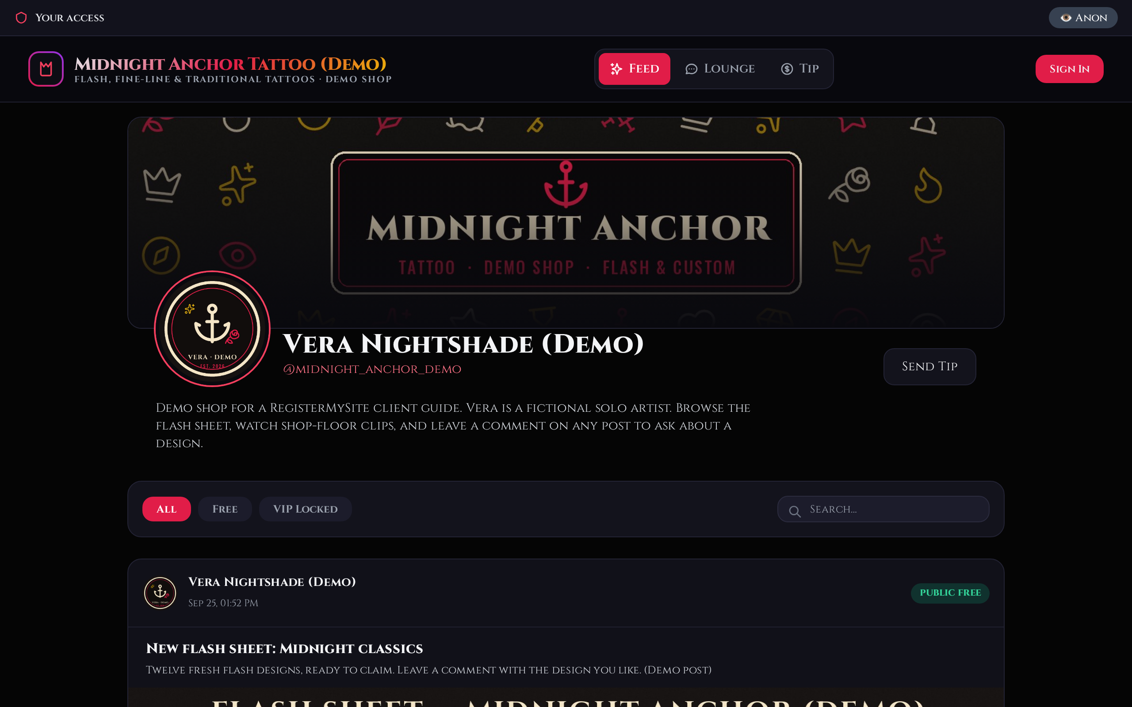







CLIENT GUIDE · FOR SOLO ARTISTS & SHOP OWNERS
YOUR SHOP,
LIVE ON
THETATTOO.MONSTER
Sign up, go live, make it look like your studio, and post your flash and shop-floor videos. Every screen in this guide is from a real demo shop we built.
Live demo thetattoo.monster/s/tattoo-monster-demo/
The finished demo shop: “Midnight Anchor Tattoo (Demo)”, a fictional artist.
Prepared by RegisterMySite · registermysite.com
Notes:
Hi everyone, and thanks for being here. Today I'll show you how to get your own tattoo shop page running on thetattoo.monster. Everything you'll see is from a real demo shop we built for this guide, Midnight Anchor Tattoo. The artist, Vera, is made up, so nothing here is a real person's work. By the end you'll know how to sign up, sign in, make the page look like your studio, and post your photos and videos. If you'd like to look around the live demo later, the address is on the slide.

Slide 2

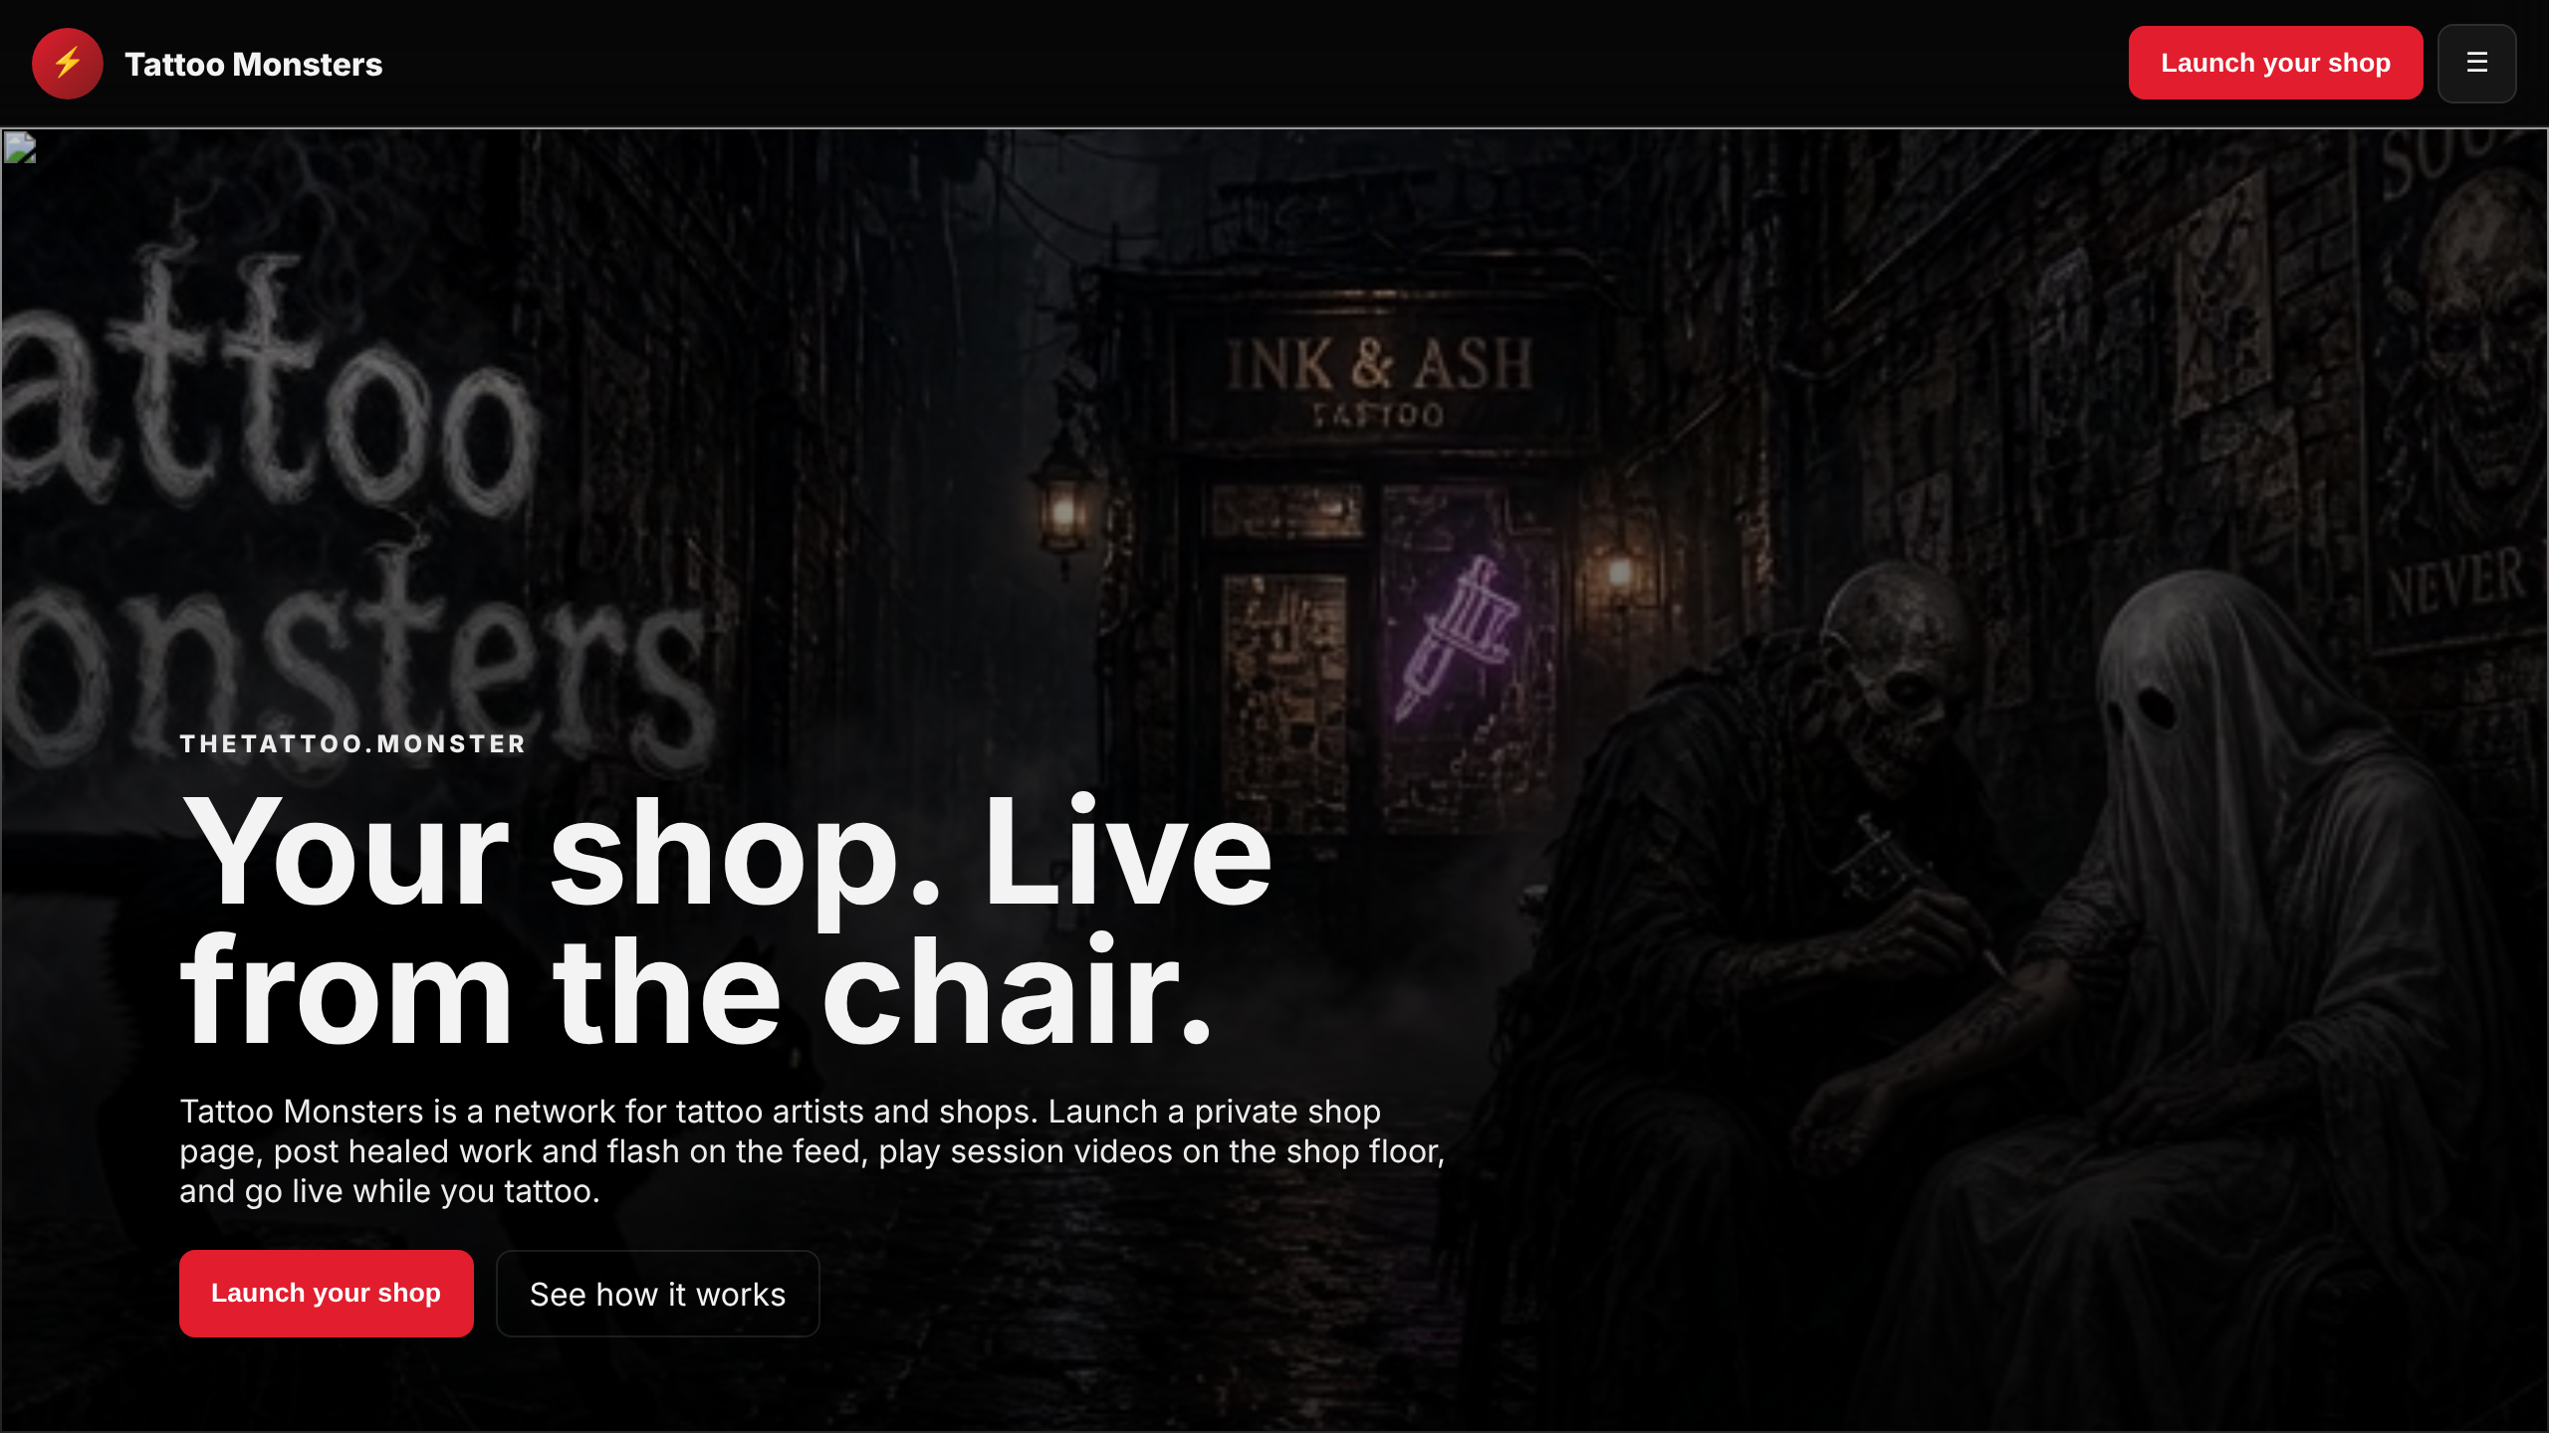




WHAT IT IS
A SHOP PAGE BUILT FOR TATTOO ARTISTS
Your own web address
thetattoo.monster/s/your-name, live the minute you launch.
Feed for photos & videos
Post flash, healed pieces and clips. Mark each one Free or VIP.
Lounge & Live Shop
Put a video on the “shop floor” screen, or go live from the chair.
The thetattoo.monster homepage. Its own headline: “Your shop. Live from the chair.”
Your look
Pick colours and a font, and add a banner and photos. No coding.
Feature list from the site’s own Instructions page (thetattoo.monster/instructions).
registermysite.com
2
Notes:
So what is thetattoo.monster? It's a website made for tattoo artists. Think of it as your shop's own page on the internet. You get your own web address. There's a feed where you post photos and videos, and you choose whether each post is free for everyone or only for VIP members. There's also a lounge where you can put a video on a shop-floor screen, and a Live Shop feature for streaming from the chair. And you can change the colours, font and photos so it looks like your studio, without touching any code. That feature list comes straight from the site's own instructions page.

Slide 3









THE JOURNEY
SEVEN STEPS FROM SIGN-UP TO YOUR FIRST POST
01
02
03
04
05
06
07
LAUNCH
SIGN IN
PASSWORD
LOOK
PHOTOS
POST
SHARE
Fill in one form and pick your web address.
Use the username and temporary password.
Swap the temporary password for your own.
Pick colours and a font, then add a bio.
Add a banner, a shop photo and your avatar.
Publish a picture and a video to the feed.
Send clients your shop link.
Good to know: there is no separate “deploy” button. Your shop is public as soon as you launch it, and every Save or Publish goes live straight away.
registermysite.com
3
Notes:
Here's the whole trip on one slide, like a flash sheet. Seven steps. First you launch the shop with one short form. Then you sign in with the temporary password the site gives you, and change it to one of your own. After that comes the fun part: colours and fonts, then your photos, then your first posts. The last step is sharing your link with clients. One thing that surprises people: there's no separate deploy or publish-my-site button. The shop is live the moment you launch it, and every change you save shows up right away. You'll see this row of steps at the bottom of the next few slides, so you always know where we are.

Slide 4

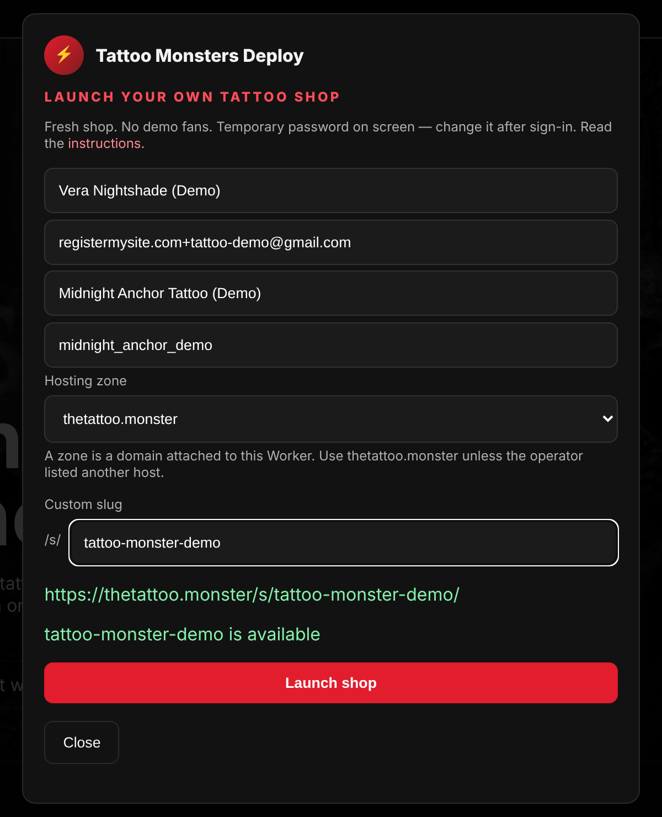
STEP 1 · LAUNCH
SIGN UP: ONE FORM, YOUR WEB ADDRESS
1
Your name
Private. Ours: “Vera Nightshade (Demo)”.
2
Email
Where the site can reach you.
1
2
3
Display name
The public shop name clients see.
3
4
4
Username
What you sign in with. 3 to 24 letters, numbers or _.
5
5
Hosting zone
Leave it on thetattoo.monster.
6
6
Custom slug
The end of your web address, e.g. tattoo-monster-demo.
7
7
Green “is available”
The site checks the address as you type.
8
8
Launch shop
Click it and your shop is created.
registermysite.com
1 LAUNCH
2 SIGN IN
3 PASSWORD
4 LOOK
5 PHOTOS
6 POST
7 SHARE
4
Notes:
Step one. On the homepage, click Launch your shop and this form pops up. Let's go through it. Your name and email are for the site, not the public. The display name is the shop name clients see. We used Midnight Anchor Tattoo, Demo. The username is what you'll sign in with, so pick something you'll remember. Leave the hosting zone as it is. The custom slug is the end of your web address. Ours is tattoo-monster-demo. As you type it, the site checks it and shows a green 'is available' line. When everything looks right, click Launch shop.

Slide 5

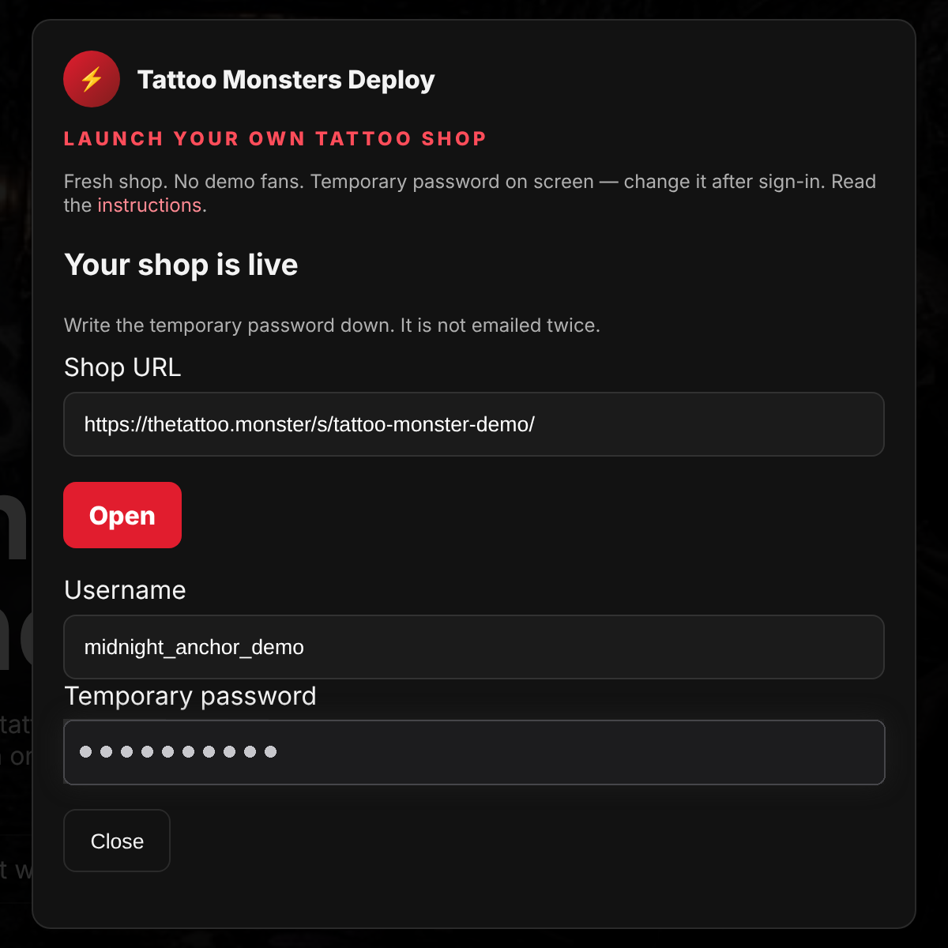

STEP 1 · LAUNCH
YOUR SHOP IS LIVE: COPY THE TEMPORARY PASSWORD
1
Shop URL
Your public web address, already live.
2
Open
Opens the new shop in your browser.
3
Username
The one you picked on the form.
1
4
Temporary password
Shown on screen. (We masked ours.)
2
3
Write it down now. The box says “It is not emailed twice.” In our test no email arrived at all, even after checking the inbox again later, so this screen was the only place to get it. Take a photo or copy it before you click Close.
4
registermysite.com
1 LAUNCH
2 SIGN IN
3 PASSWORD
4 LOOK
5 PHOTOS
6 POST
7 SHARE
5
Notes:
As soon as you click Launch shop, you get this screen: Your shop is live. Number one is your web address, and it already works. Number two, Open, takes you straight there. Number three is your username. Number four is the important one: the temporary password. We masked ours, but on your screen you'll see it in full. Please write it down right now. The box says it isn't emailed twice. When we tested it, no email arrived at all, so this screen was the only copy. Take a photo of it or copy it somewhere safe before you close the box.

Slide 6

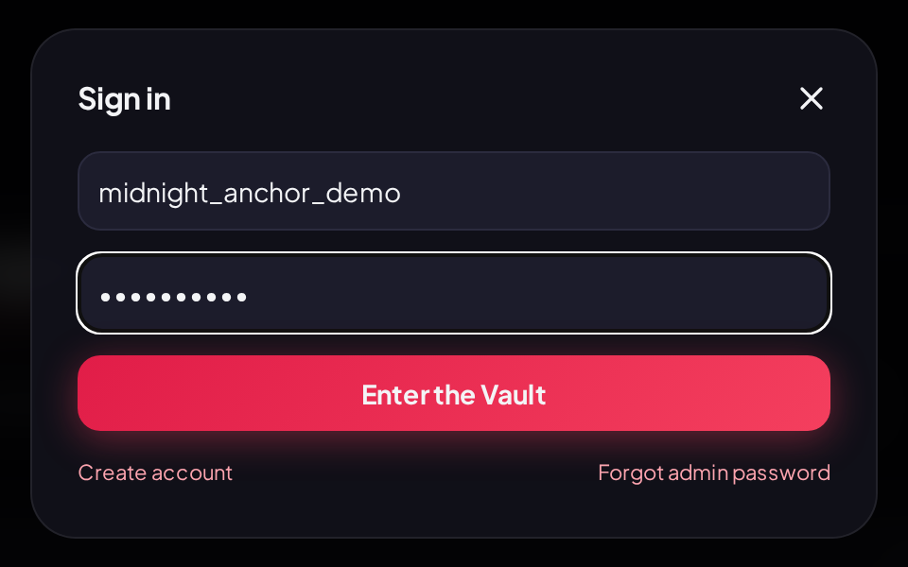
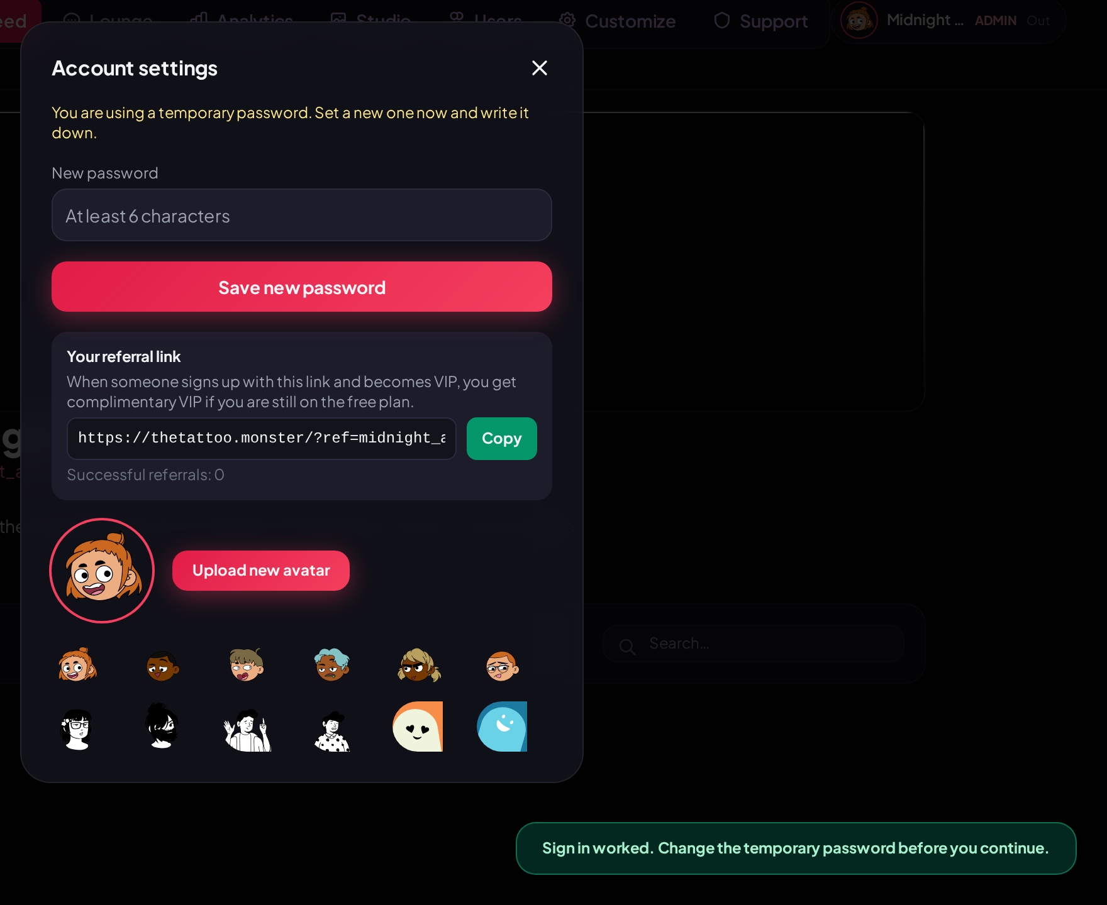
STEP 2 · SIGN IN
FIRST SIGN-IN WITH THE TEMPORARY PASSWORD
4
1
2
3
1
Click Sign In (top right), type your username
5
2
Paste the temporary password
The dots hide it as you type.
3
Click “Enter the Vault”
4 Yellow reminder 5 “Sign in worked. Change the temporary password…”
registermysite.com
✓ LAUNCH
2 SIGN IN
3 PASSWORD
4 LOOK
5 PHOTOS
6 POST
7 SHARE
6
Notes:
Step two. Open your shop and click Sign In in the top-right corner. Type your username, paste the temporary password, and click the button. It's called Enter the Vault, which is a fun touch. Right away the site opens your Account settings. You'll see a yellow reminder that you're using a temporary password, and a message in the corner: Sign in worked, change the temporary password before you continue. That's all normal. It's the site nudging you to the next step.

Slide 7

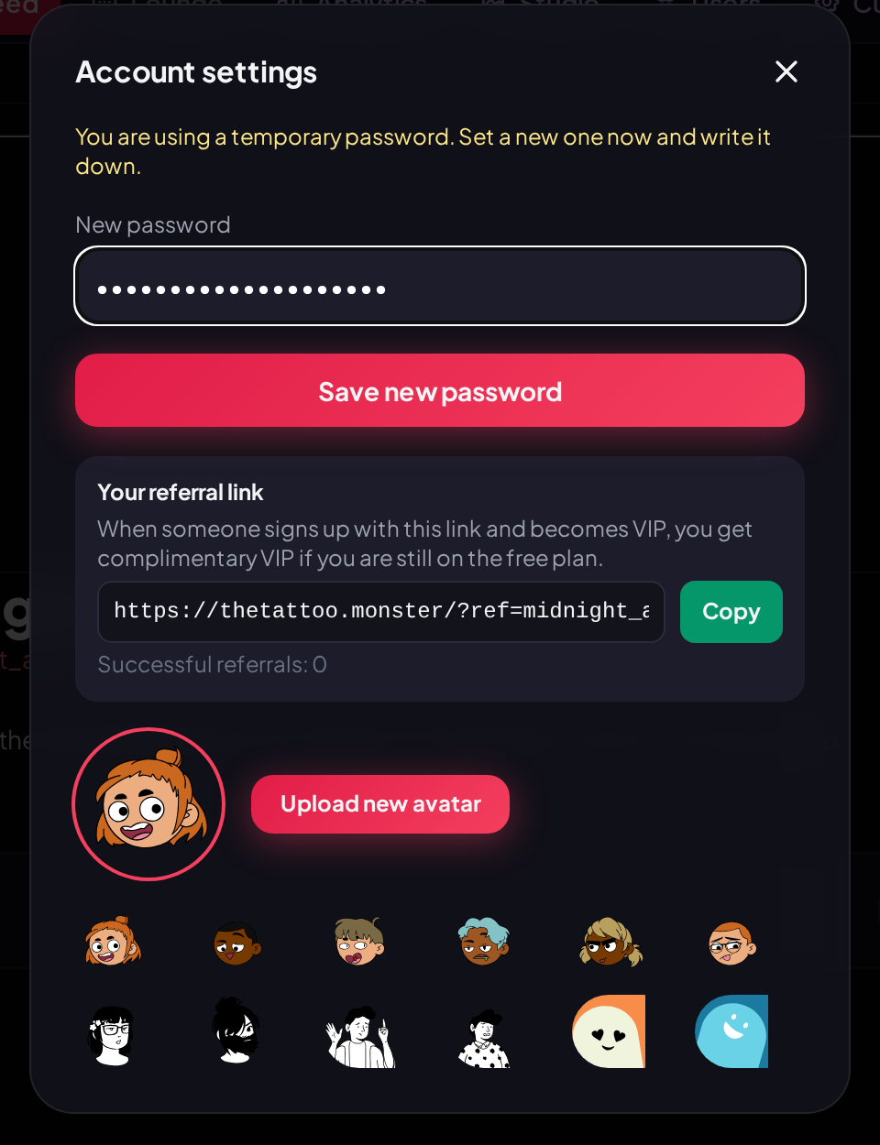


STEP 3 · PASSWORD
SWAP IN A PASSWORD ONLY YOU KNOW
1
Account settings opens by itself
Later, click your avatar pill (top right) to get back here.
1
2
Type a new password
At least 6 characters. Longer is better. Ours is 20 random characters.
2
3
3
Click “Save new password”
You’ll see a green confirmation.
← the green message you’re looking for
Keep a copy. Store it in a password manager or somewhere safe. If you ever get locked out, there is a “Forgot admin password” link on the Sign in box.
registermysite.com
✓ LAUNCH
✓ SIGN IN
3 PASSWORD
4 LOOK
5 PHOTOS
6 POST
7 SHARE
7
Notes:
Step three is quick but important. In the Account settings box, type a new password in the New password field. The site's minimum is six characters, but please go much longer. We used a twenty-character random one from a password manager. Click Save new password and you'll see the green message: Password saved, keep a written copy. If you need this box again later, just click your little avatar pill in the top-right corner. And if you ever forget the password, there's a Forgot admin password link on the Sign in box.

Slide 8


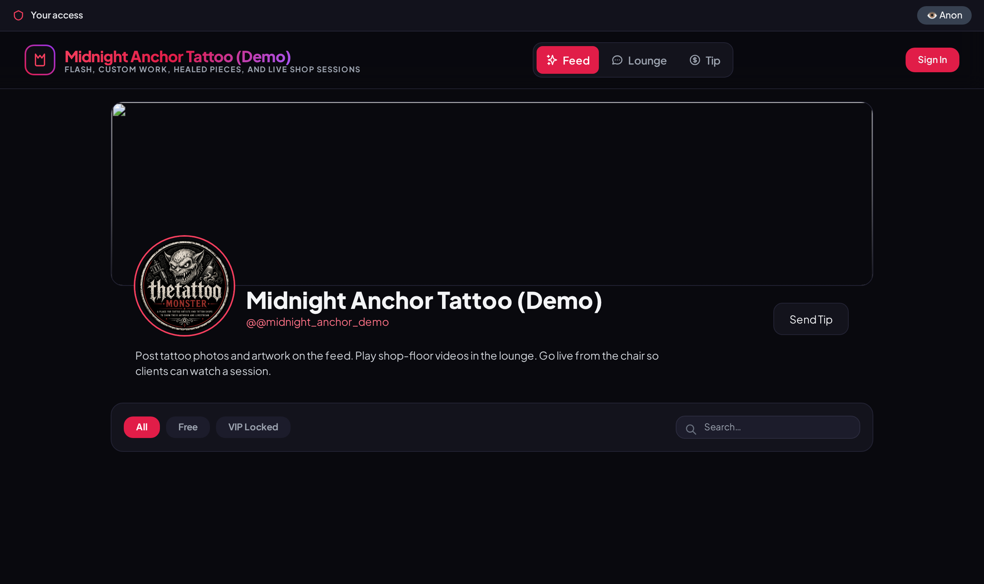

THE “DEPLOY” MOMENT
YOUR SHOP IS ALREADY LIVE, JUST EMPTY
https://thetattoo.monster/s/tattoo-monster-demo/
1
Shop name & tagline
From your sign-up form. You can edit both in Customize.
1
2
Banner area
On a brand-new shop this showed a broken-image icon. Step 5 fixes it.
2
3
Default shop photo
The thetattoo.monster logo until you add your own.
3
4
4
Handle shows “@@”
A small glitch. Type the handle without the @ in Customize.
No deploy button: launching published it. Everything next is decoration.
registermysite.com
8
Notes:
People always ask how to deploy or publish the site. Good news: you already did. When you clicked Launch shop, this page went live at your web address. Here's what a brand-new shop looks like. Number one is your shop name and tagline from the form. Number two is the banner area. On our new shop it showed a broken-image icon, which isn't pretty. We'll replace it with our own banner in a minute. Number three is a placeholder photo, the thetattoo.monster logo. And number four: the handle showed two @ signs. That's a small glitch, and the fix is easy. I'll show you on the fonts slide. So from here on, everything we do is decorating a shop that's already open.

Slide 9

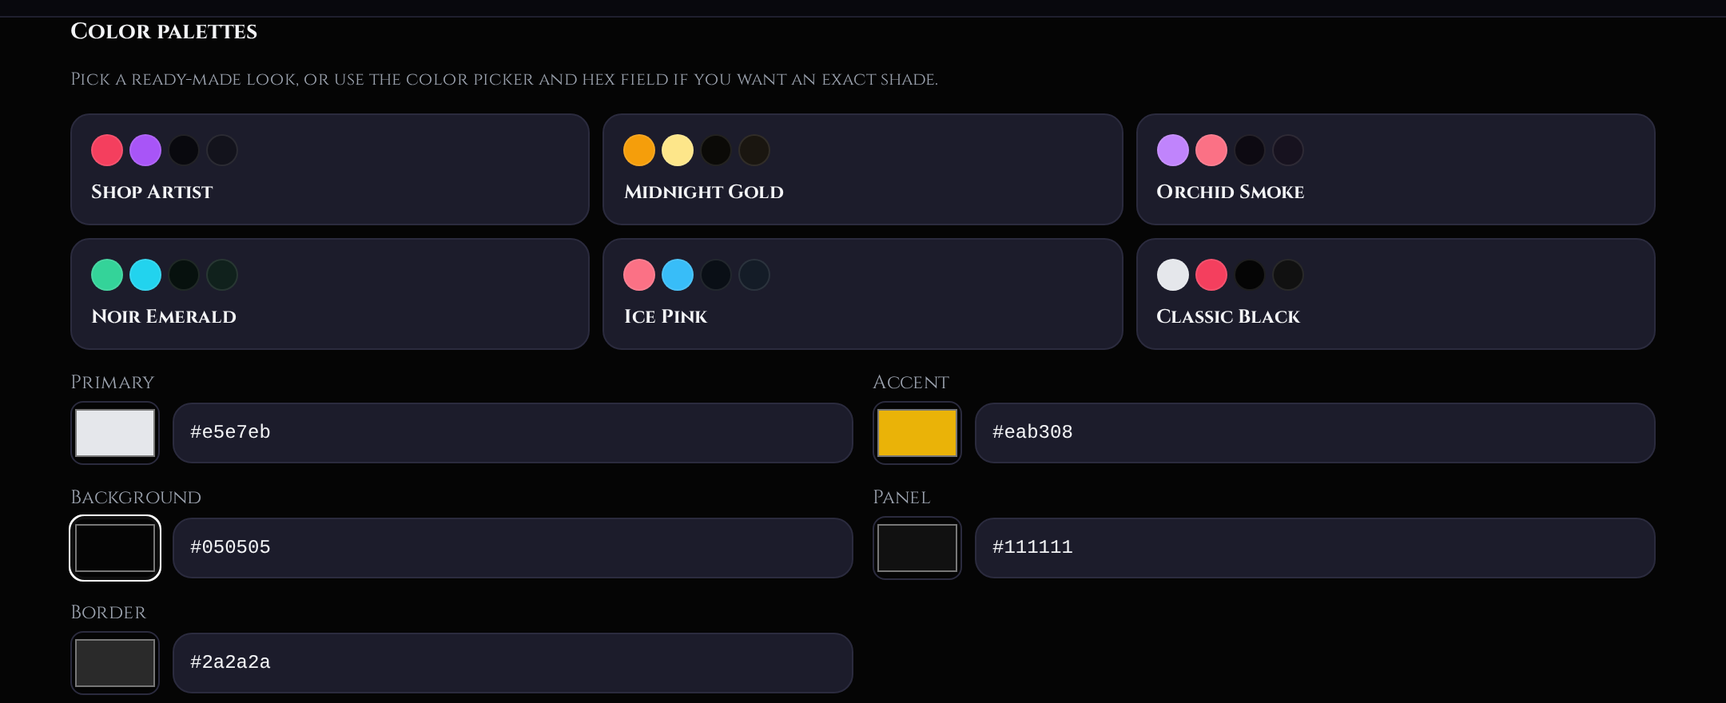
STEP 4 · LOOK
COLOURS: PICK A PALETTE, THEN FINE-TUNE
1
Click a palette
Customize → Color palettes. We picked “Classic Black”.
1
2
Adjust any colour
Use the swatch or type a hex code.
2
3
3
Make it yours
We changed Accent to gold, #EAB308.
4
Save customization
At the bottom. Wait for “Customization saved”.
4
OUR FINAL COLOURS
Primary
Accent
Background
Panel
Border
registermysite.com
✓ LAUNCH
✓ SIGN IN
✓ PASSWORD
4 LOOK
5 PHOTOS
6 POST
7 SHARE
9
Notes:
Now the fun part. Click the Customize tab at the top of your shop and scroll to Color palettes. Number one: pick a ready-made palette. There are six. We chose Classic Black because it fits a traditional tattoo look. Number two: you can fine-tune any colour with the little swatch or by typing a colour code. Number three: we changed the accent to gold so it matches our flash art. And number four, which people forget: scroll to the bottom and click Save customization. Nothing changes on your live page until you see the Customization saved message.

Slide 10

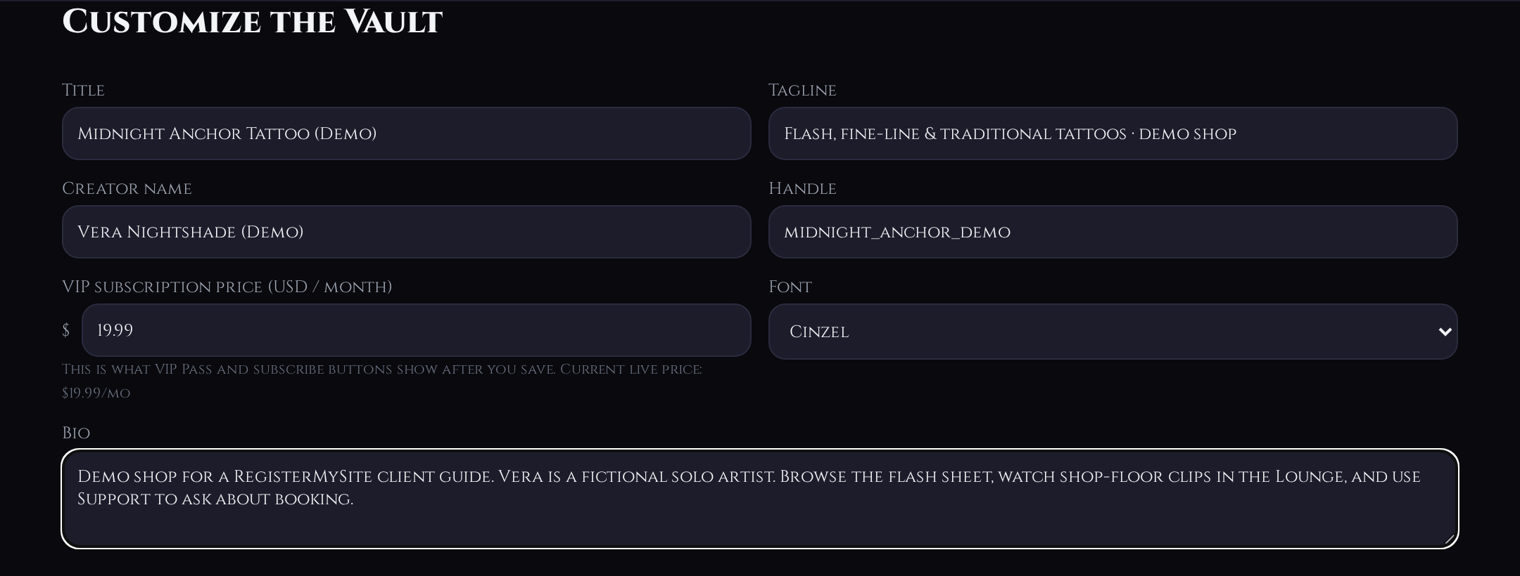


STEP 4 · LOOK
FONTS, TAGLINE, BIO AND HANDLE
2
1
Font
20 to choose from. We picked Cinzel.
3
4
2
Tagline
One short line under your shop name.
1
3
Creator name
The artist name on your posts.
5
4
Handle: leave out the “@”
The site adds one. Typing it gave us “@@”.
BEFORE: default font
AFTER: Cinzel
5
Bio
Two or three friendly sentences.
Tip: fancy display fonts like Cinzel look great in headings but are harder to read in long text. Check your bio on a phone after saving.
registermysite.com
✓ LAUNCH
✓ SIGN IN
✓ PASSWORD
4 LOOK
5 PHOTOS
6 POST
7 SHARE
10
Notes:
Still in Customize, at the top of the form, you set the words and the font. Number one is the font menu. There are twenty choices, from clean modern fonts to classic serif ones. We picked Cinzel because it feels like old-school signage. You can see the before and after at the bottom. Number two is your tagline, the short line under your shop name. Number three is the creator name, which shows on your posts. Number four is the handle. Type it without the @ sign. The site adds one for you, and if you type your own you get two. Number five is your bio. Keep it short and friendly. Then, as always, click Save customization at the bottom.

Slide 11

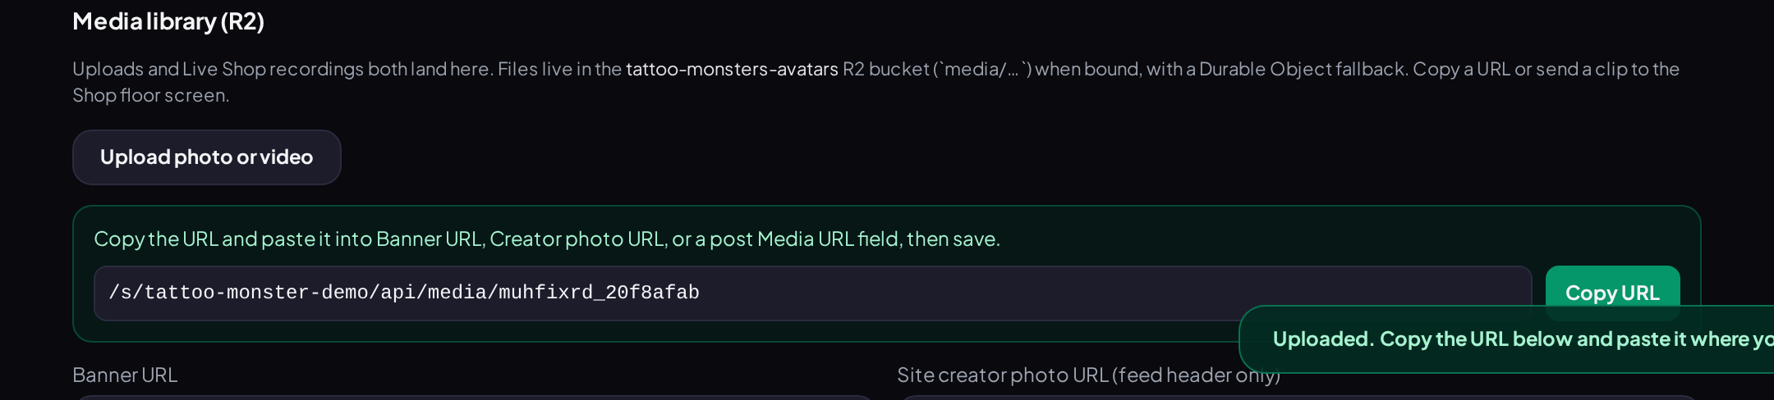
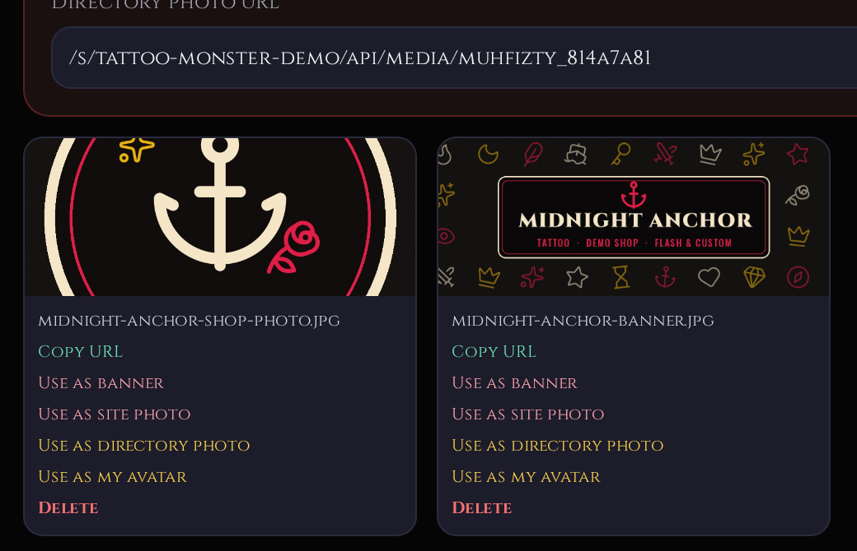
STEP 5 · PHOTOS
UPLOAD ONCE, THEN “USE AS…”
1
Upload photo or video
Customize → Media library. Pick a file from your computer.
1
2
2
A web link appears
Copy URL is there if you need it. Usually you don’t.
3
Use as banner
On your banner image in the library.
4
Use as site photo
Your shop’s profile picture on the feed.
5
Use as directory photo
Optional. The picture the site directory can show.
3
4
5
6
Save customization
Same button as before, at the bottom.
registermysite.com
✓ LAUNCH
✓ SIGN IN
✓ PASSWORD
✓ LOOK
5 PHOTOS
6 POST
7 SHARE
11
Notes:
Step five is photos. Everything goes through the Media library, which is in the Customize tab. Number one: click Upload photo or video and pick a file. Number two: when it's done, you get a green box with a web link. You can copy it, but usually you don't need to. Your file now appears as a little card with buttons. Number three: on your banner image, click Use as banner. Number four: on your shop photo, click Use as site photo. Number five, optional: Use as directory photo, which is the picture the site's shop directory can use. And number six, you guessed it: Save customization.

Slide 12

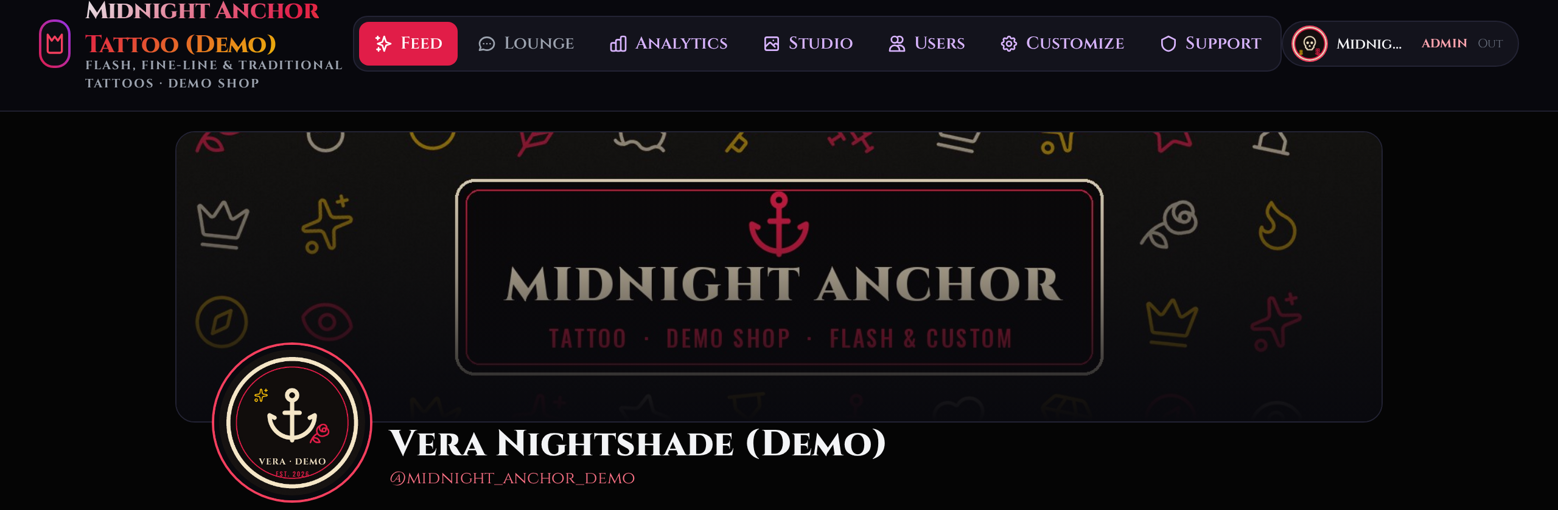
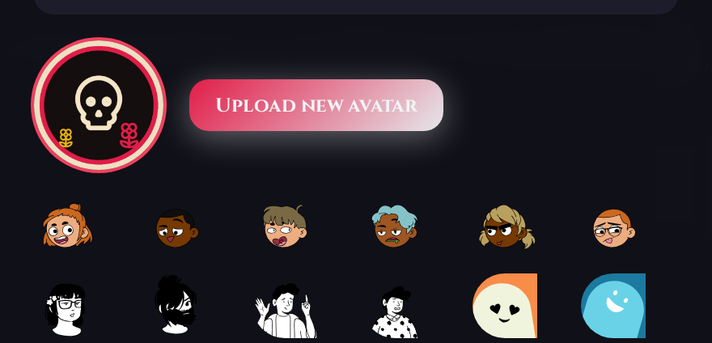



STEP 5 · PHOTOS
THREE PICTURES, THREE DIFFERENT SPOTS
4
3
1
2
1
Banner
Media library → Use as banner.
THE IMAGES WE MADE FOR THE DEMO (our own flash-art designs)
2
Shop photo (profile picture)
Media library → Use as site photo.
1
2
3
3
Your avatar
Your personal account picture.
4
Upload new avatar
Click your avatar pill → Account settings. Or pick a cartoon.
registermysite.com
✓ LAUNCH
✓ SIGN IN
✓ PASSWORD
✓ LOOK
5 PHOTOS
6 POST
7 SHARE
12
Notes:
This part confuses almost everyone, so let's slow down. There are three different pictures. Number one is the banner, the wide image across the top. Number two is the shop photo, the round profile picture next to your name. The site calls it the site creator photo. Number three is your avatar. That's your personal account picture, the little circle in the top-right corner when you're signed in. The banner and shop photo come from the Media library, like on the last slide. The avatar is set in Account settings: click your avatar pill, then Upload new avatar, number four. There are also some cartoon avatars to pick from. Along the bottom are the three images we designed for the demo. They're our own flash-art graphics, not stock photos of a real person.

Slide 13

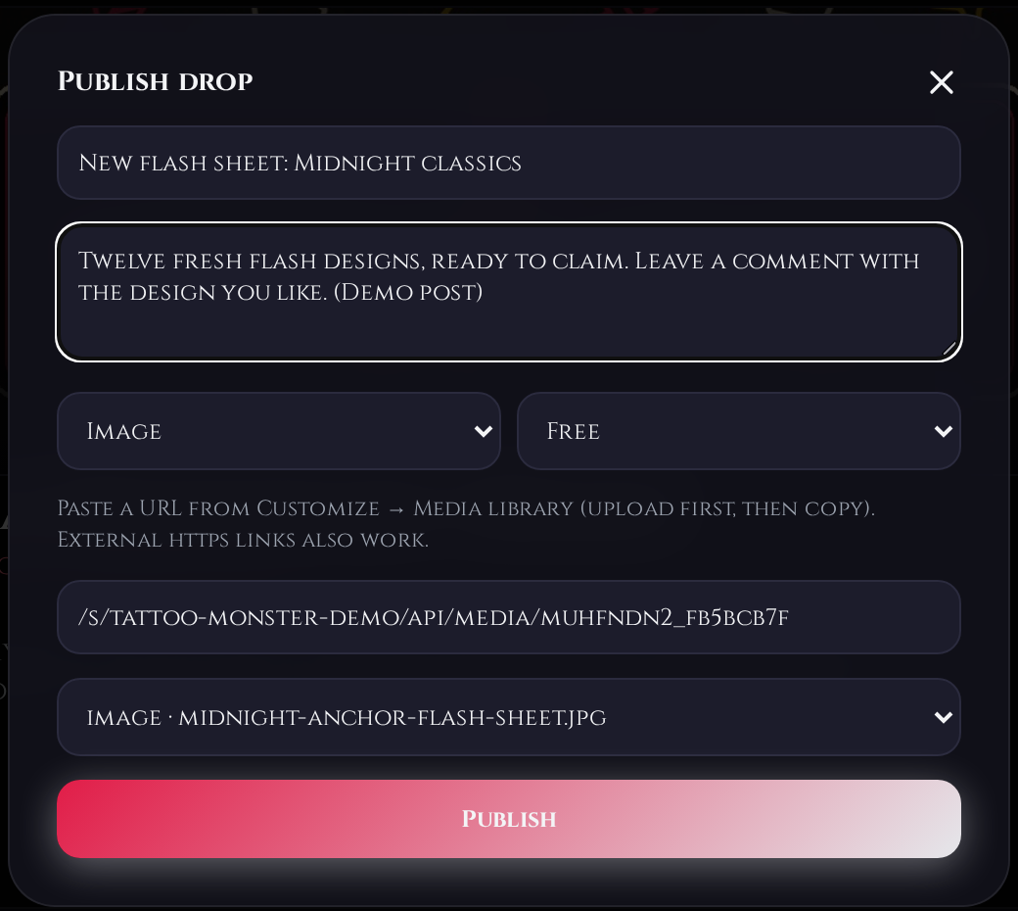
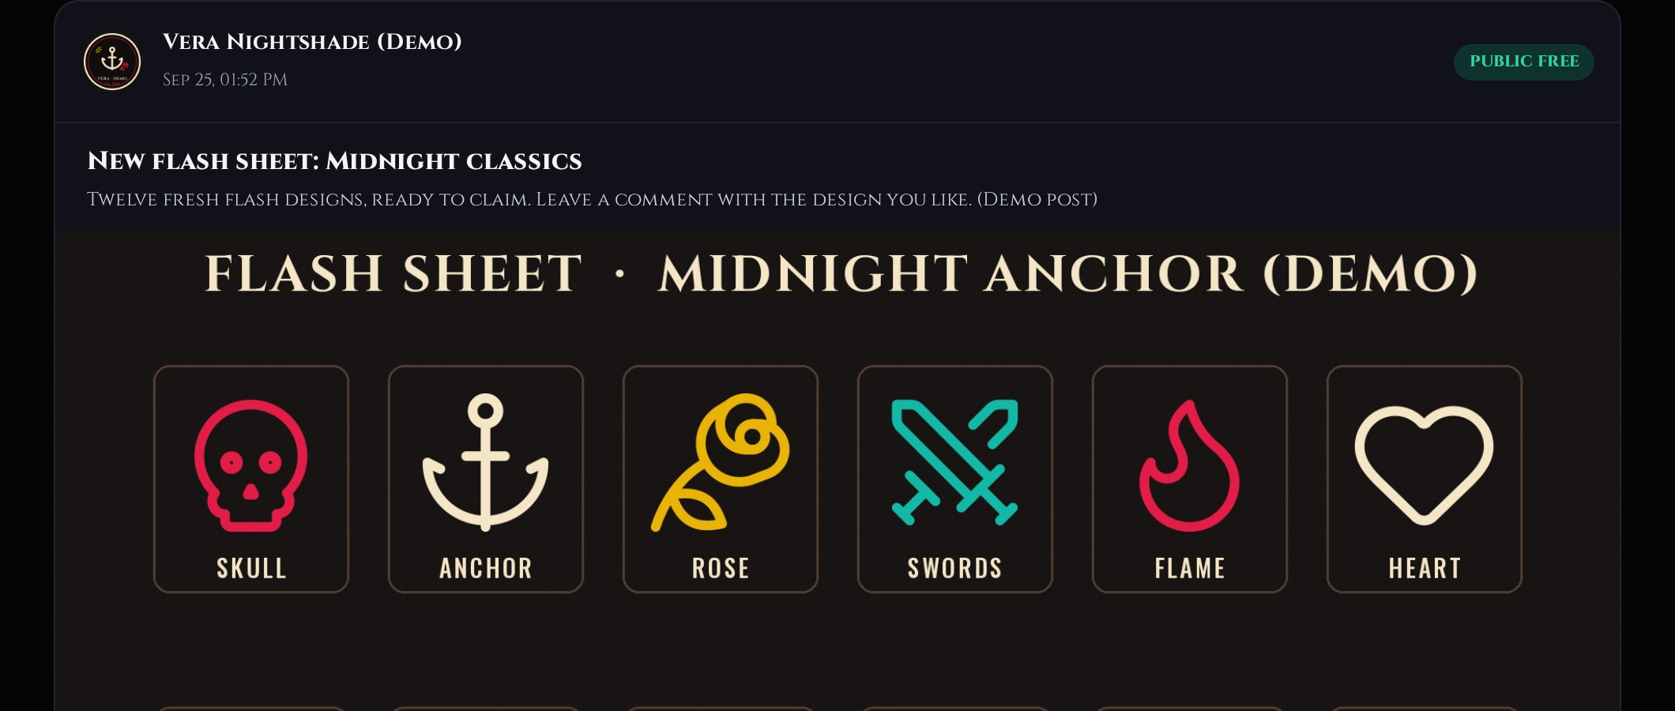
STEP 6 · POST
POST A PICTURE: STUDIO → NEW DROP
1
2
3
4
WHAT CLIENTS SEE ON THE FEED
1
Title
2
Caption (say how clients can claim it)
5
3
Type: Image
4
Tier: Free (or VIP locked)
6
5
Pick the file you uploaded (or paste its link)
6
Publish
registermysite.com
✓ LAUNCH
✓ SIGN IN
✓ PASSWORD
✓ LOOK
✓ PHOTOS
6 POST
7 SHARE
13
Notes:
Step six: posting. First upload your picture in the Media library, the same way as the banner. Then click the Studio tab and the New drop button. Give it a title, number one, and a caption, number two. Tell people how to claim a design. We said 'leave a comment with the design you like.' Number three: set the type to Image. Number four: choose Free so everyone can see it, or VIP locked for paying members only. Number five: pick the file you uploaded from the list. Number six: Publish. On the right is what clients see: our flash sheet at the top of the feed with a Public free label.

Slide 14

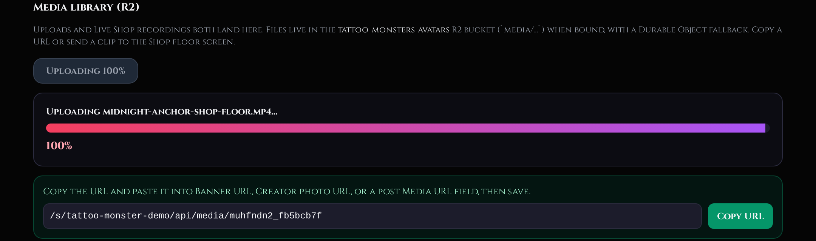
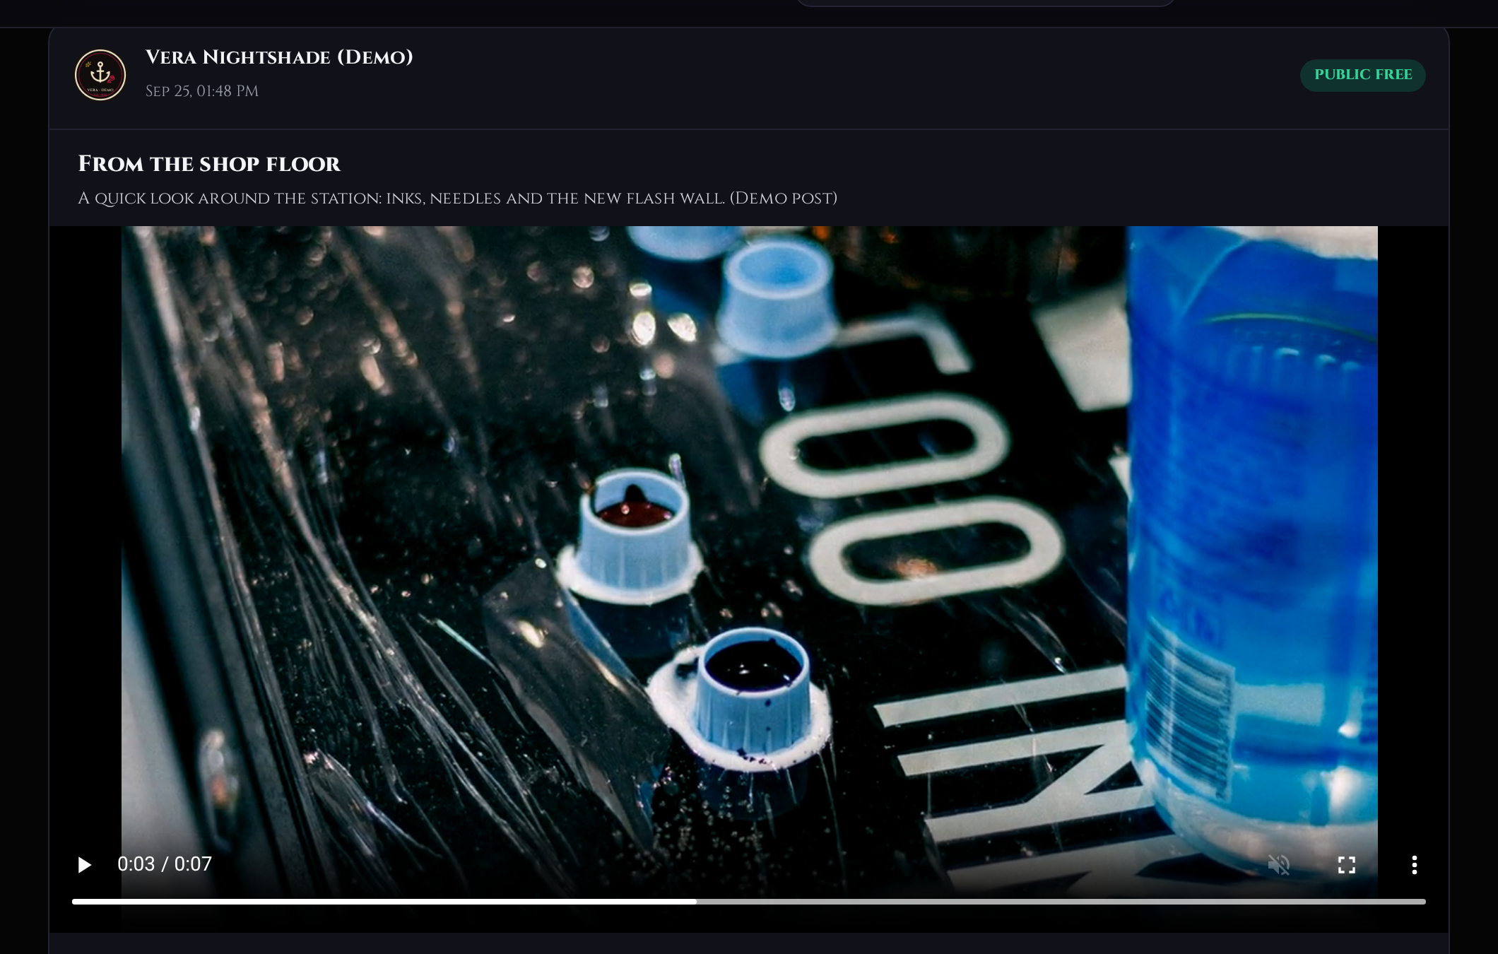
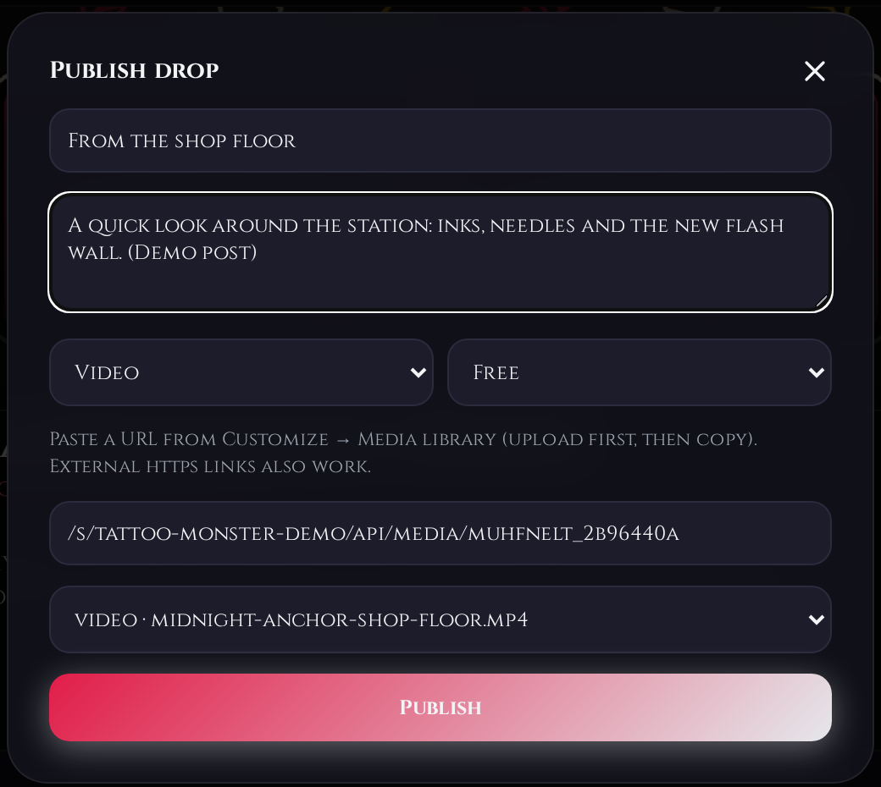

STEP 6 · POST
POST A VIDEO: SAME STEPS, TYPE “VIDEO”
1
2
5
1 Upload the video in the Media library and watch the progress bar.
2 Wait for the green link box.
3 In New drop, set Type to Video.
4 Pick the .mp4, choose Free, Publish.
3
4
Keep clips short. Ours is 8 seconds, 1280×720, 0.85 MB. Heads-up: on the feed, the video showed a black box until someone pressed play (5 shows it playing).
registermysite.com
✓ LAUNCH
✓ SIGN IN
✓ PASSWORD
✓ LOOK
✓ PHOTOS
6 POST
7 SHARE
14
Notes:
Videos work the same way. Upload the file in the Media library. You'll see a progress bar with a percentage, number one, and then the green link box, number two. Then go to Studio, New drop, and set the type to Video, number three. Pick your MP4, number four, leave it on Free, and publish. Number five shows it playing on the live feed. Two tips. Keep clips short. Ours is eight seconds and under one megabyte, so it uploads fast and loads fast for clients. And don't panic if the video looks like a black box on the feed. In our test the preview stayed black until you pressed play. The video itself is fine.

Slide 15

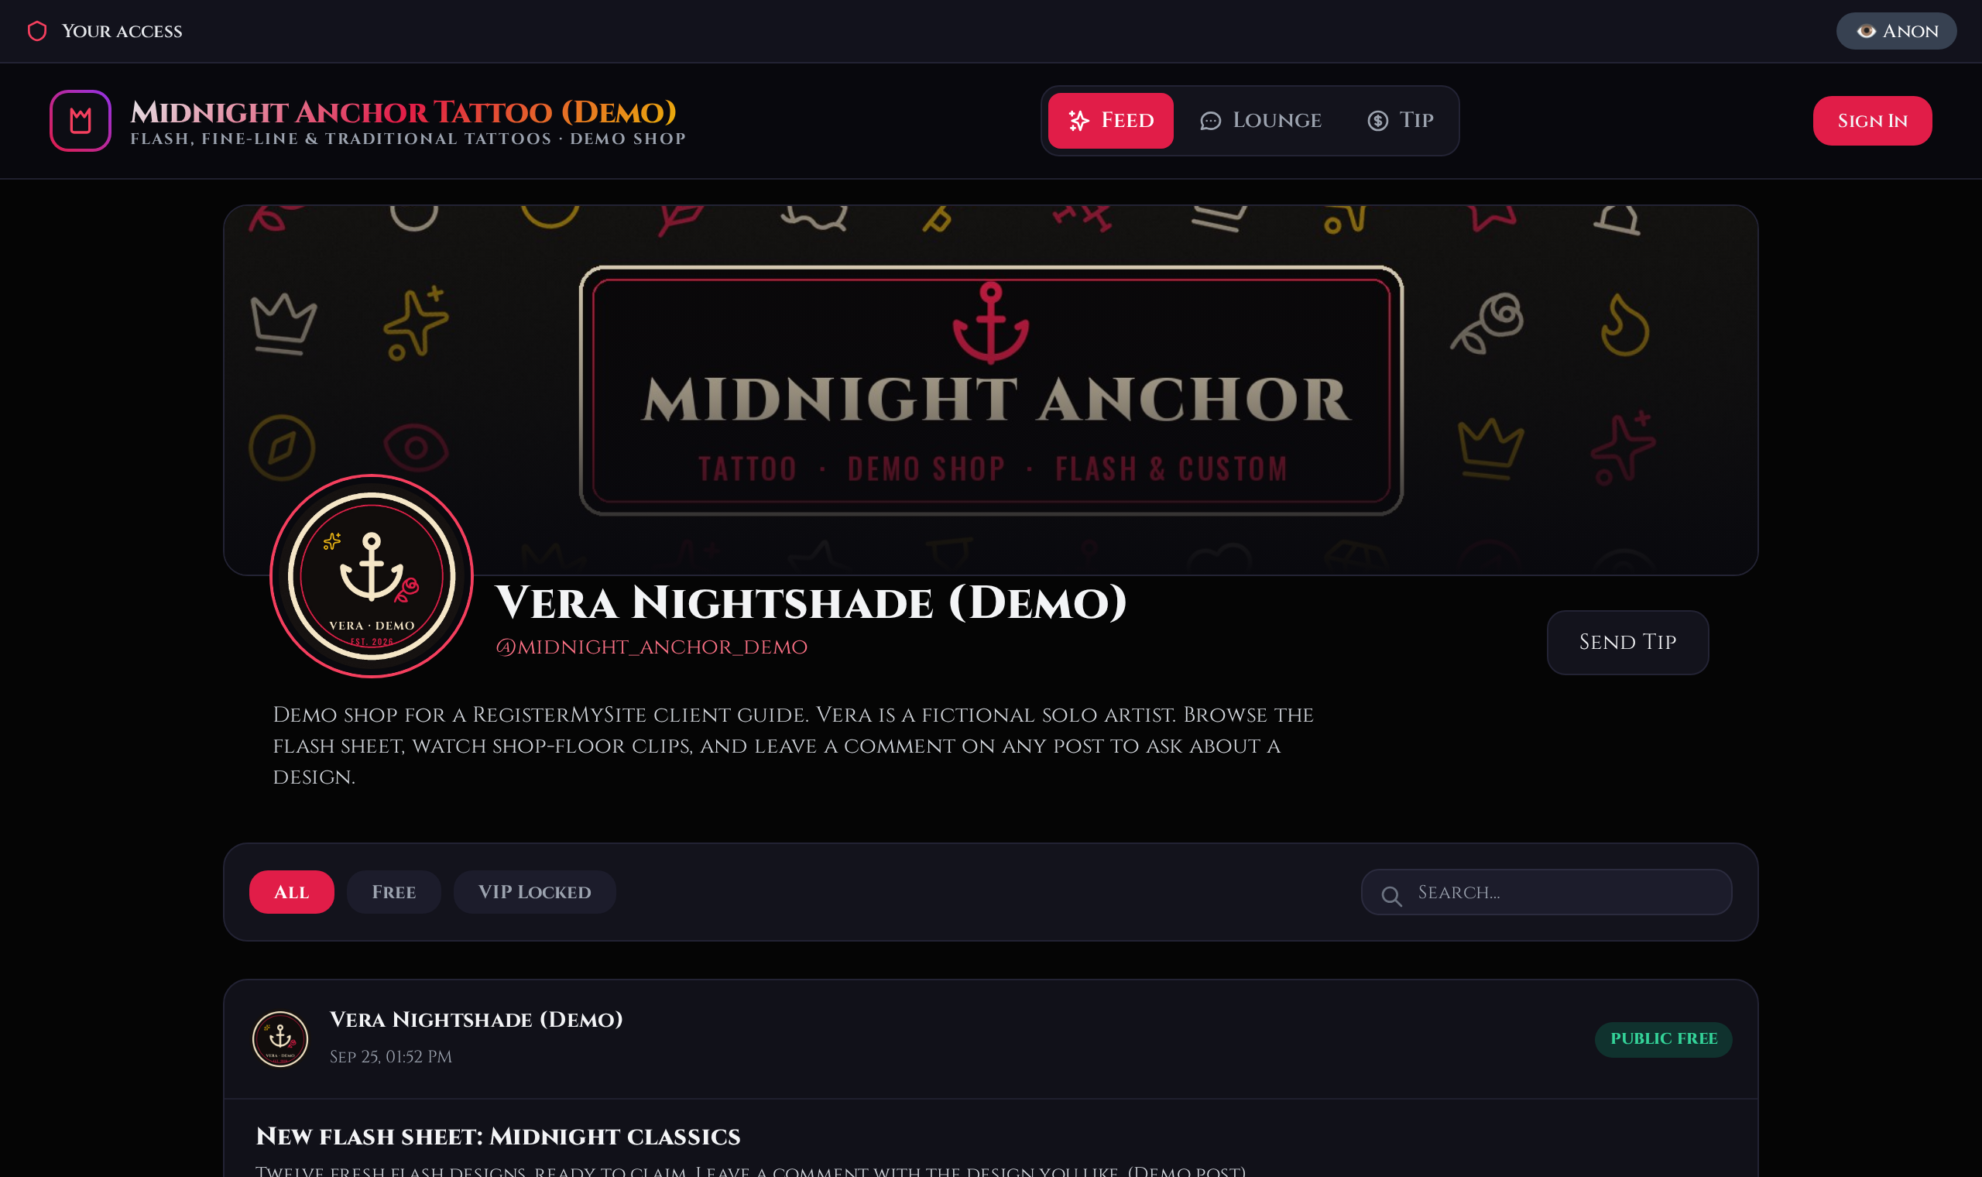
STEP 7 · SHARE
THE FINISHED SHOP: BEFORE AND AFTER
BEFORE
AFTER
thetattoo.monster/s/tattoo-monster-demo/
Classic Black + gold
Cinzel font
Own banner
Own shop photo
New bio & handle fix
1 picture + 1 video
registermysite.com
✓ LAUNCH
✓ SIGN IN
✓ PASSWORD
✓ LOOK
✓ PHOTOS
✓ POST
7 SHARE
15
Notes:
And here's the payoff. On the left is the shop right after launch, with the broken banner, the placeholder logo and the default font. On the right is the same shop after about a dozen clicks: Classic Black colours with a gold accent, the Cinzel font, our own banner and shop photo, a real bio, the handle fixed, and two posts on the feed. Step seven is just sharing that link, the address in the bar, with your clients. Put it in your Instagram bio, on your business cards, wherever people find you.

Slide 16






EVERYDAY USE
HABITS THAT KEEP YOUR SHOP LOOKING SHARP
POSTING = TWO STOPS
DELETE IS INSTANT
SHOP FLOOR SCREEN
Upload in Customize → Media library, then Studio → New drop. Every time.
Studio’s Delete button removes a post straight away. There’s no “are you sure?” and no undo.
Lounge → Upload video to screen. Choose how long it stays up: 30 minutes up to no expiry.
CLIENTS NEED AN ACCOUNT
SUPPORT = THE SITE TEAM
ANALYTICS COUNTS YOU TOO
Signed-out visitors can look, but commenting and the Lounge ask them to sign in first.
The Support tab is a private chat with the thetattoo.monster team, not a client inbox.
Your own visits show up. Ours showed 14 visits, all from us setting up the demo.
registermysite.com
16
Notes:
A few habits that'll save you headaches. Posting is always two stops: upload in the Media library, then publish from Studio. Be careful with Delete in Studio. It removes the post immediately, with no are-you-sure box and no undo. The Lounge has a shop floor screen where you can put a video up for a set time, from thirty minutes to forever. Your clients can look at your feed without an account, but to comment or get into the Lounge they need to sign in or create a free account. The Support tab is for talking to the thetattoo.monster team about the platform. It isn't where clients message you. And analytics counts your own visits too. Our demo showed fourteen visits, and every one was us setting it up.

Slide 17

TROUBLESHOOTING
MESSAGES WE ACTUALLY SAW, AND WHAT TO DO
WHAT YOU SEE
WHAT IT MEANS
WHAT TO DO
“Invalid credentials”
Username or password doesn’t match.
Use your username, not your email. Check caps lock.
“Password must be at least 6 characters”
New password too short.
Go longer. A password manager can make one.
“Sign in worked. Change the temporary password before you continue.”
Normal on first sign-in.
Set a new password in Account settings.
“Sign in or create an account first”
A signed-out visitor tried the Lounge or Tip.
Nothing is broken. Visitors just need an account.
Broken-image icon in the banner
New shops start with a banner that didn’t load.
Upload your own banner (step 5).
Handle shows “@@yourname”
The handle was saved with an @.
Remove the @ in Customize → Handle and save.
Video is a black box on the feed
No preview frame until it plays.
Press play. The video is fine.
Red pills are exact on-screen messages from our demo. The last three are things we saw on the page itself.
registermysite.com
17
Notes:
Here's a cheat sheet of messages we actually ran into while building the demo, so you'll know them when you see them. Invalid credentials means the username or password doesn't match. Use your username, not your email, and check caps lock. Password must be at least six characters means the new password is too short. Sign in worked, change the temporary password, is normal the first time you sign in. Sign in or create an account first is what signed-out visitors see if they try the Lounge or Tip. Nothing's broken. The last three aren't pop-up messages, they're things we saw on the page: the broken banner on a new shop, the double @ in the handle, and videos showing as a black box until you press play. Each has an easy fix on the right.

Slide 18

RECAP
WHERE TO CLICK, ALL ON ONE PAGE
1
LAUNCH
Homepage → Launch your shop → fill in the form → Launch shop → copy the temporary password
2
SIGN IN
Your shop → Sign In → username + temporary password → Enter the Vault
3
PASSWORD
Account settings → New password → Save new password
4
LOOK
Customize → palette, colours, font, tagline, bio, handle (no @) → Save customization
5
PHOTOS
Customize → Media library → Upload → Use as banner / site photo → Save. Avatar: avatar pill → Upload new avatar
6
POST
Media library → Upload → Studio → New drop → Image or Video, Free → pick file → Publish
7
SHARE
Send clients your link: thetattoo.monster/s/your-slug/
registermysite.com
18
Notes:
Let's pull it together. This slide has every click in order, so it's a good one to print or screenshot. Launch from the homepage and copy your temporary password. Sign in with it. Change the password. Set your look in Customize and save. Add photos through the Media library, and your avatar through the avatar pill. Post by uploading first, then Studio and New drop. And share your link. That's really all there is to it.

Slide 19





NEED A HAND?
WE’LL SET IT UP
WITH YOU.
RegisterMySite can walk you through launching and styling your thetattoo.monster shop, step by step.
registermysite.com
LIVE DEMO
(562) 751-4597
thetattoo.monster/s/tattoo-monster-demo/
info@registermysite.com
In person in LA & Orange County
Platform help: thetattoo.monster lists no phone or email. Use the Support tab inside your shop.
registermysite.com
19
Notes:
That's the tour. If you'd like help setting up your own shop, that's what we do. You can reach RegisterMySite at registermysite.com, call us at 562-751-4597, or email info@registermysite.com. We also meet in person around LA and Orange County. The demo shop is still live at the address on the card if you want to click around. One last note: thetattoo.monster doesn't list a phone number or email for itself. For platform problems, use the Support tab inside your shop. Thanks so much. Any questions?

